Slide 1



Verdant Metrics: Sales Performance Analysis

Slide 2

Learning Objectives
Understand the end-to-end process of sales data analysis using Power BI.
Develop skills in data transformation, modeling, and visualization.
Gain insights into sales trends, profitability, and key performance indicators (KPIs).
Learn to create interactive dashboards for data-driven decision-making.
GOAL
Source :
www.freepik.com/

Slide 3
Tools and Technology used
Data Source: Kaggle (Downloaded sales dataset)
Data Processing & Analytics: Power BI
Power Query: Data transformation and cleaning
DAX (Data Analysis Expressions): Creating measures and calculated columns
Power BI Visualization: Building interactive dashboards

Slide 4
Methodology
Data Acquisition – Downloaded raw dataset from Kaggle.
Data Cleaning & Transformation – Used Power Query for formatting and structuring data.
Data Modeling – Created relationships, calculated measures using DAX.
Visualization & Dashboarding – Built interactive Power BI reports to analyze trends.
Analysis & Insights – Identified patterns, KPIs, and business recommendations.

Slide 5
Problem Statement:
The dataset from Kaggle lacked an intuitive way to analyze sales trends, account profitability, and product performance effectively.
Traditional data exploration methods made it challenging to derive actionable insights regarding sales trends, product contributions, and regional market dynamics.

Slide 6
Solution:
Developed an interactive Power BI dashboard to visualize sales performance metrics.
Incorporated key insights such as YTD vs. PYTD comparisons and profitability segmentation.
Highlighted sales trends over time to identify seasonal patterns.
Treemaps and product breakdown charts provided regional and category insights.
Interactive slicers enabled dynamic data exploration for better decision-making.

Slide 7
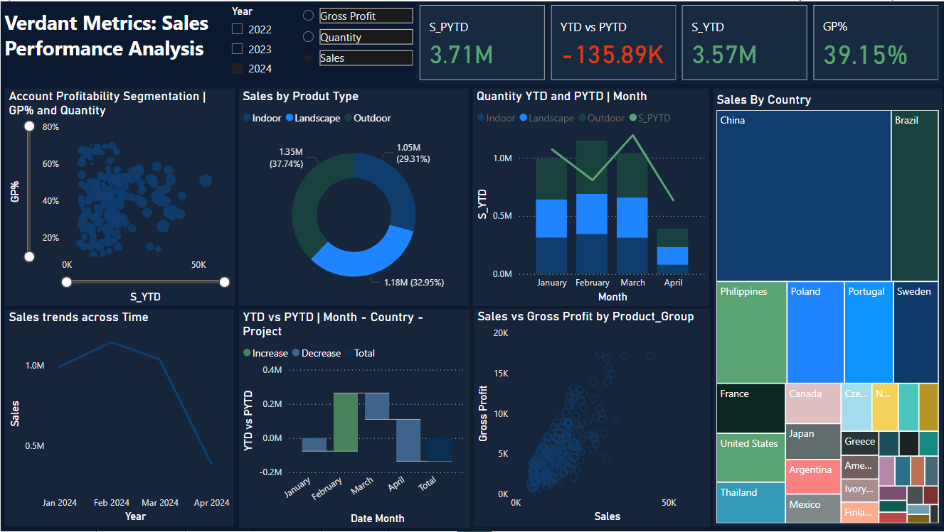
Screenshot of Output:

Slide 8
Conclusion:
This Power BI dashboard empowers stakeholders to monitor sales trends, track regional performance, and optimize business decisions based on profitability insights.
The interactive nature of the dashboard facilitates dynamic exploration, promoting data-driven decision-making.

